Slide 1

AAVA INDUSTRIES PVT LTD
COMPLETE CUSTOMER SATISFACTION
Plant Address:
PLOT No B1-B2,Sno 28. Opp to Motel the Vill.Haripal Pal. Rajkot
rajkot@ aavaauto.com
9824855757

Slide 2
Our Vision
To be most customer centric company
Our Mission
We would strive to offer our customer the lowest possible price, the best available solutions and utmost convenience.

Slide 3

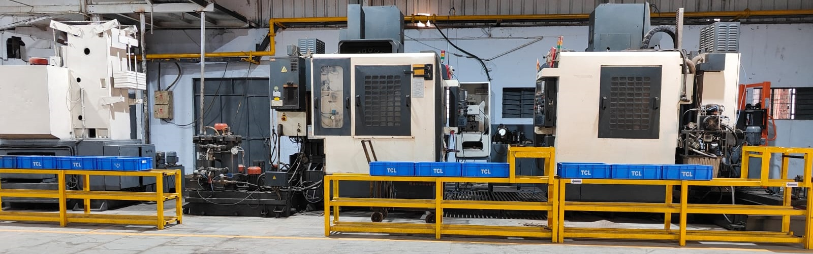
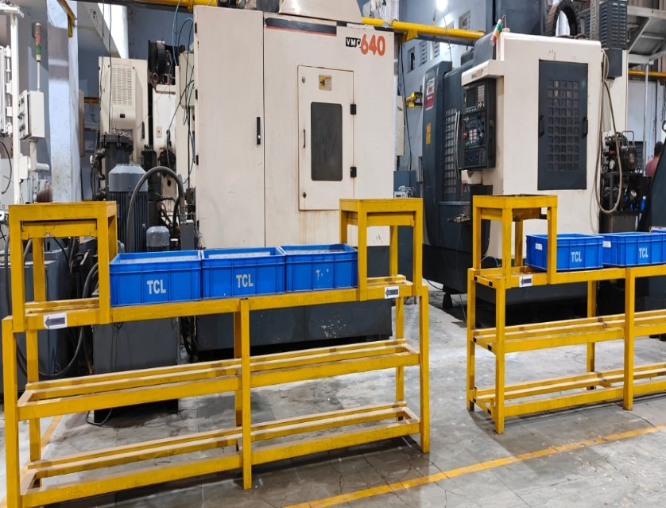
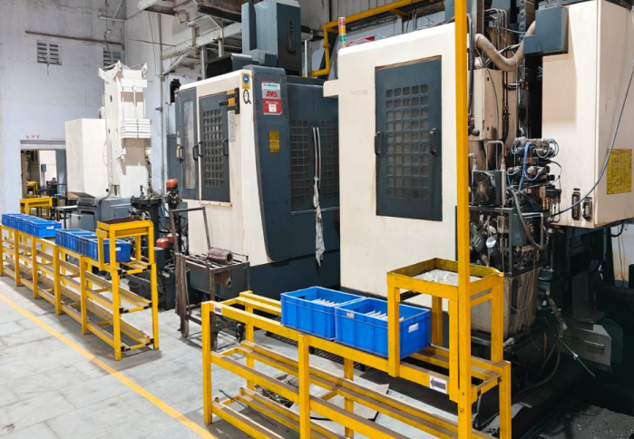
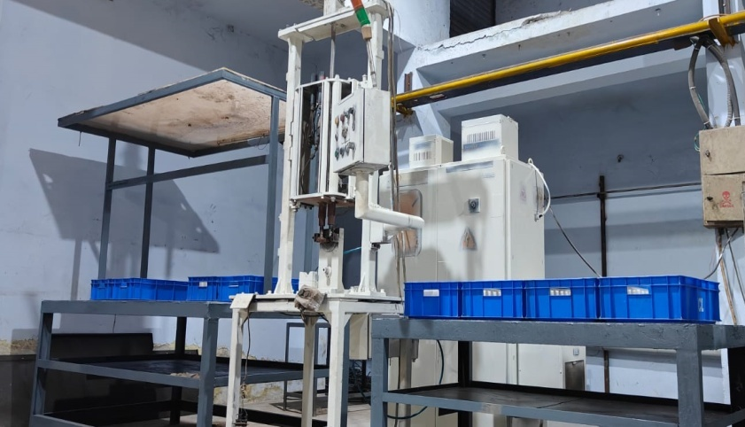
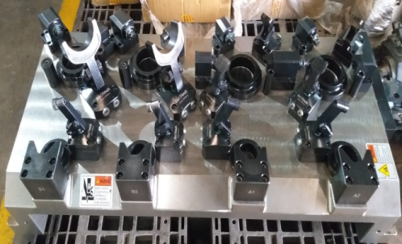

About Our Company
AAVA was formed in 2021 at Rajkot and in engaged in machining of 5 C from Jamshedpur and Rajkot.
At AAVA we ensure to provide simple machining solution for all complex manufacturing concerns.
We strive to reduce waste, optimize productivity, re-aligning operations with business strategies effectively by using voice of all our stake holders.
We have state of art Manufacturing facilities with experienced Team Members .

Slide 4
About us:
We are having 22 + years of manufacturing experience in forging and casting parts.
Consultants to many Tier1 and OEM for NPD
Excellent team for tooling and machine design.
Capable of developing parts with forging and castings
Have excellent tie up with forging and casting supplier.
Excellent machining set up for machining Six cylinder cylinder Head , Cylinder Block and Connecting Rod.
Head Qtr at Rajkot.

Slide 5
Special Features
Material Handling through conveyor
Single piece Flow
On-line SPC
Auto recording of Data
Visual Display
Experienced Manpower
Better part cleanliness
DG for power Backup
Crane & Forklift for material movement
Camera on shop floor
Complete customer satisfaction

Slide 6
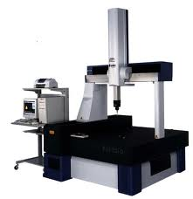
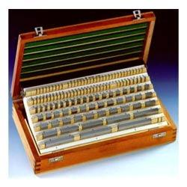
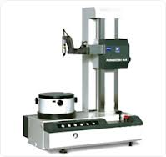
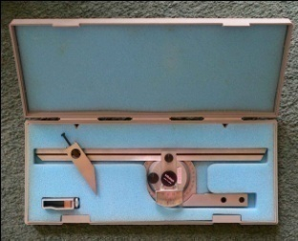
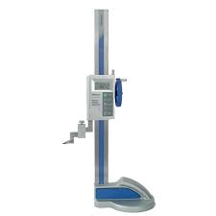
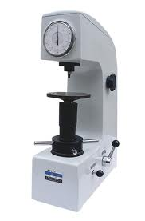
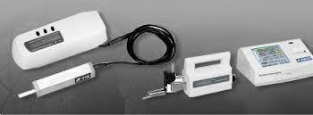
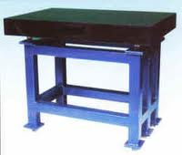
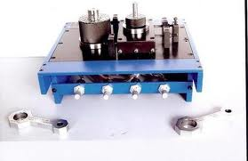
Inspection Facilities
Description | Images | Description | Images
CMM |  | Pin gauge & Slip gauge
Roundness tester |  | Bevel protector
Height gauge |  | Hardness tester
Roughness tester |  | Surface plate
Electronic bend & twist gauge |  | Height gauge Trimos

Slide 7
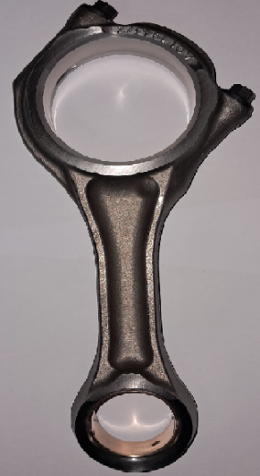
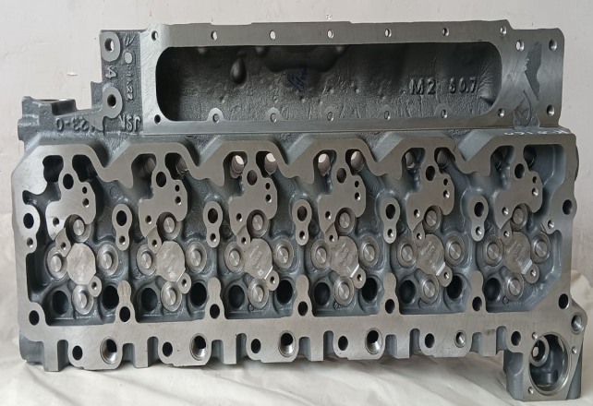
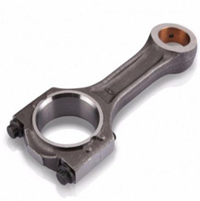
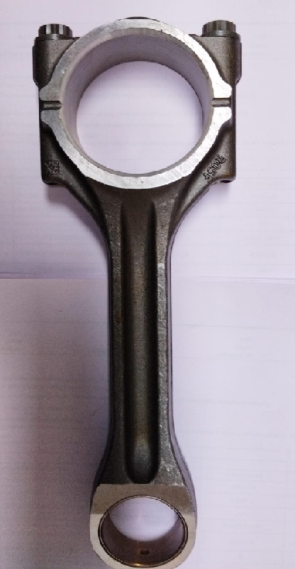
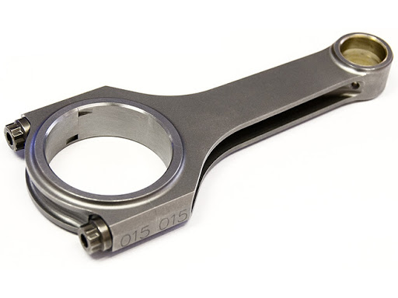
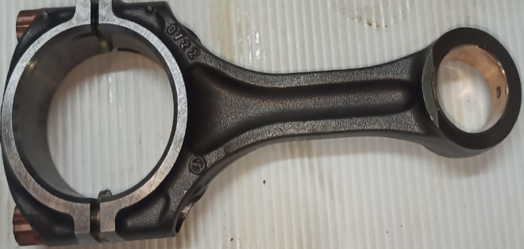
Our Products

Slide 8





Clientele

Slide 9
Thank You

